Slide 1

"‘Repligate’: reproducibility in statistical studies. What does it mean and in what sense does it matter?"
Stephen Senn

Slide 2
Outline
A brief word from John
The crisis of replication?
A brief history of P-values
What are we looking for in replication?
Empirical evidence
Another brief word from John
Notes:
Various authors have suggested recently, that there is a crisis of reproducibility in science with subsequent studies failing to replicate the results of their predecessors. Many seem to be of the opinion that the cult of significance is particularly to blame and some have suggested that this could be solved by increasing the stringency of the standard for significance. Others have suggested using confidence intervals as a cure. Still others have suggested that Bayesian methods should be substituted instead. However, all these proposals are rather puzzling and raise a number of questions. What is a reasonable probability of a result being reproduced? How is it considered to have been reproduced? Is it only reproducibility of significance that matters or should non-significance also be reproducible? If the common level s of significance are to be made more stringent does this apply to subsequent studies also? Since of any two P-values, provided that nothing else is known, the probability that the first is lower than the second (excluding ties) is 1/2 and vice versa, how would this solve the problem? How big should any replicating study be? Should it be the same size as the original one and if so why? Since no two Bayesians are required to agree with each other in what sense could two Bayesian statements based on independent studies and prior information replicate each other and why should anyone care? On the other hand, if one talks about updating reproducibility, since prior distributions are exchangeable with the data to the degree defined by the model, what relevance does replication have to Bayesian updating?

Slide 3
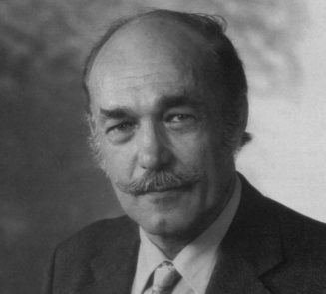
John Nelder on Significance & Reproducibility
Notes:
From John Nelder’s presidential address
1. Nelder JA. Statistics, Science and Technology. Journal of the Royal Statistical Society Series A-Statistics in Society 1986; 149: 109-121.

Slide 4
The Crisis of Replication
In countless tweets….The “replication police” were described as “shameless little bullies,” “self-righteous, self-appointed sheriffs” engaged in a process “clearly not designed to find truth,” “second stringers” who were incapable of making novel contributions of their own to the literature, and—most succinctly—“assholes.”
Why Psychologists’ Food Fight Matters
“Important findings” haven’t been replicated, and science may have to change its ways.
By Michelle N. Meyer and Christopher Chabris , Science
Notes:
See
http://www.slate.com/articles/health_and_science/science/2014/07/replication_controversy_in_psychology_bullying_file_drawer_effect_blog_posts.html

Slide 5
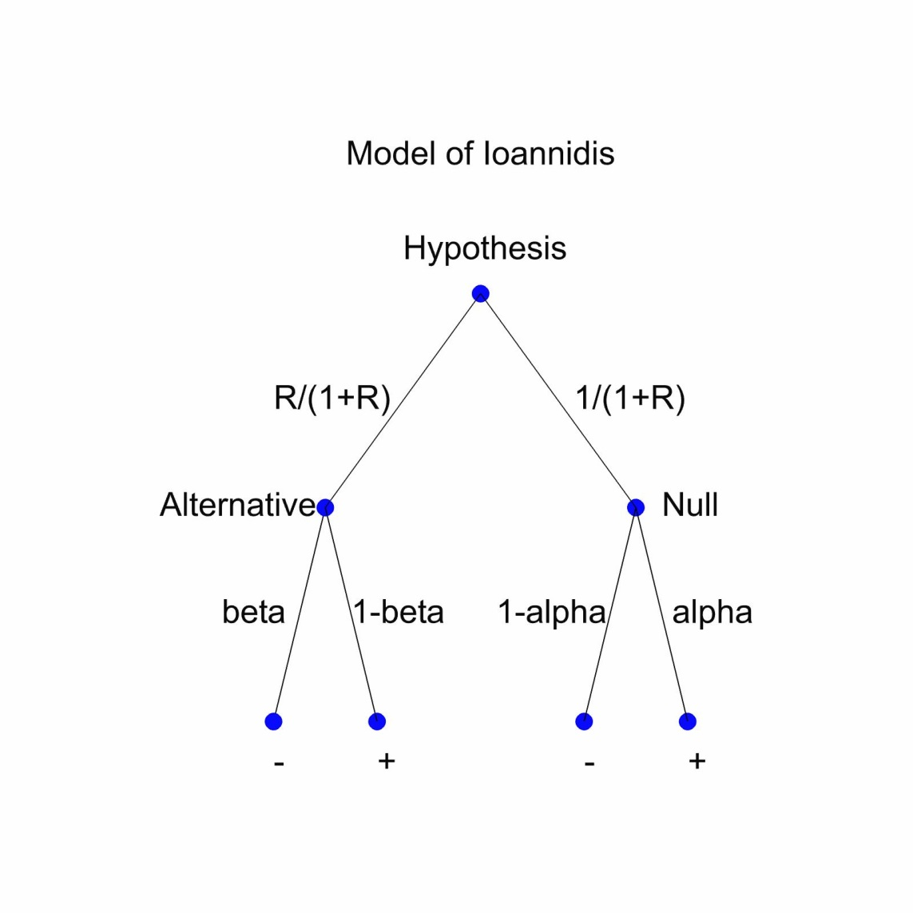
Ioannidis (2005)
Claimed that most published research findings are wrong
  By finding he means a ‘positive’ result
2652 citations by 22 March 2015 according to Google Scholar

Slide 6
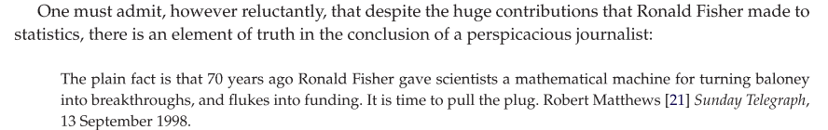
Colquhoun’s Criticisms
“If you want to avoid making a fool of yourself very often, do not regard anything greater than
p <0.001 as a demonstration that you have discovered something. Or, slightly less stringently,
use a three-sigma rule.”
Royal Society Open Science 2014
Notes:
1. Colquhoun D. An investigation of the false discovery rate and the misinterpretation of p-values. Royal Society Open Science 2014; 1: 140216.

Slide 7
A Common Story
Scientists were treading the path of Bayesian reason
Along came RA Fisher and persuaded them into a path of P-value madness
This is responsible for a lot of unrepeatable nonsense
We need to return them to the path of Bayesian virtue
In fact the history is not like this and understanding this is a key to understanding the problem

Slide 8
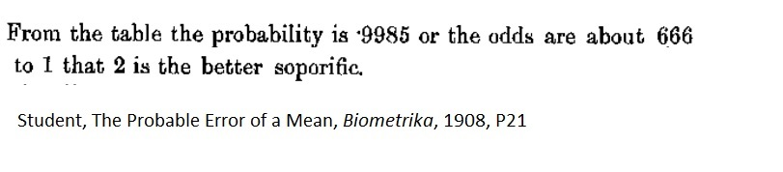
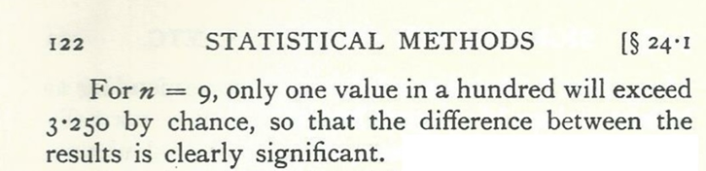
Fisher, Statistical Methods for Research Workers, 1925
Notes:
Here n is not the sample size but the degrees of freedom

Slide 9
The real history
Scientists before Fisher were using tail area probabilities to calculate posterior probabilities
Fisher pointed out that this interpretation was unsafe and offered a more conservative one
Jeffreys, influenced by CD Broad’s criticism, was unsatisfied with the Laplacian framework and used a lump prior probability on a point hypothesis being true
It is Bayesian Jeffreys versus Bayesian Laplace that makes the dramatic difference, not frequentist Fisher versus Bayesian Laplace

Slide 10
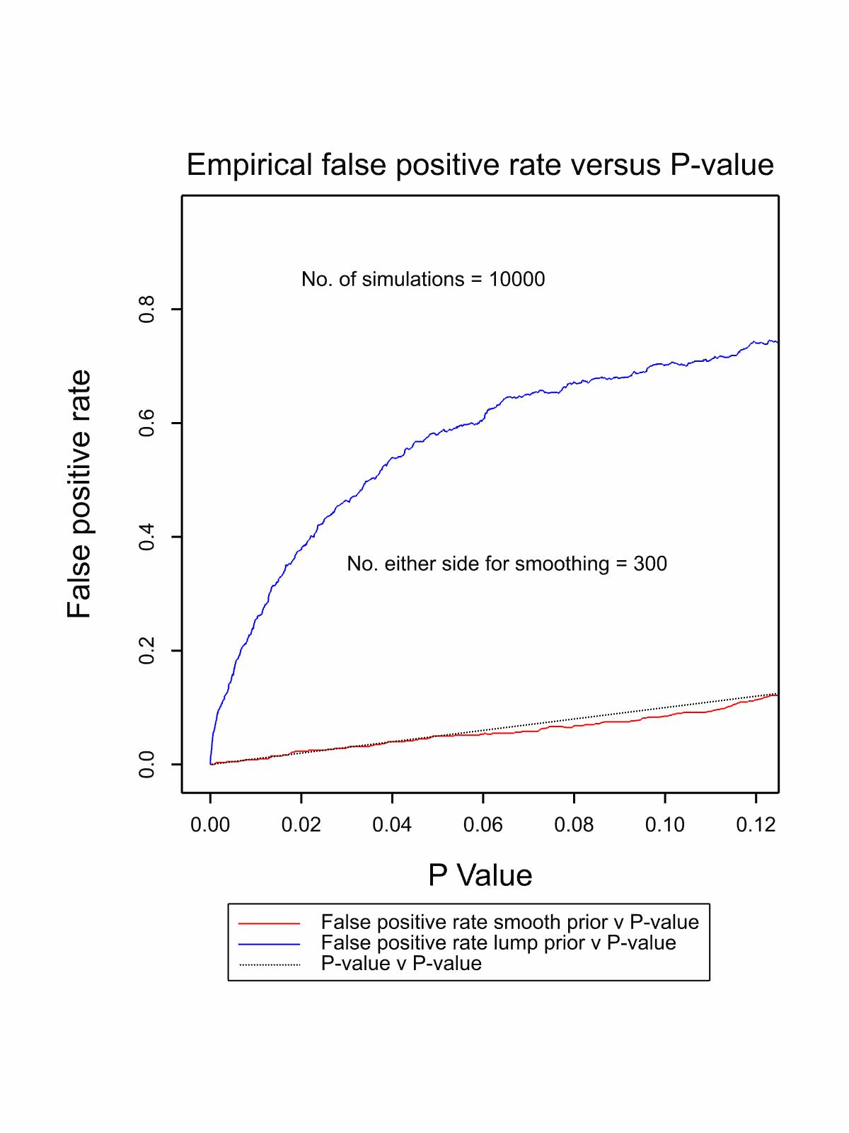

Slide 11
Why the difference?
Imagine a point estimate of two standard errors
Now consider the likelihood ratio for a given value of the parameter, δ under the alternative to one under the null
  Dividing hypothesis (smooth prior) for any given value δ = δ’ compare to δ = -δ’
  Plausible hypothesis (lump prior) for any given value δ = δ’ compare to δ = 0

Slide 12
A speculation of mine
Scientists had noticed that for dividing hypotheses they could get ‘significance’ rather easily
  The result is the 1/20 rule
However when deciding to choose a new parameter or not in terms of probability it is 50% not 5% that is relevant
This explains the baffling finding that significance test are actually more conservative than AIC (and sometimes than BIC)

Slide 13
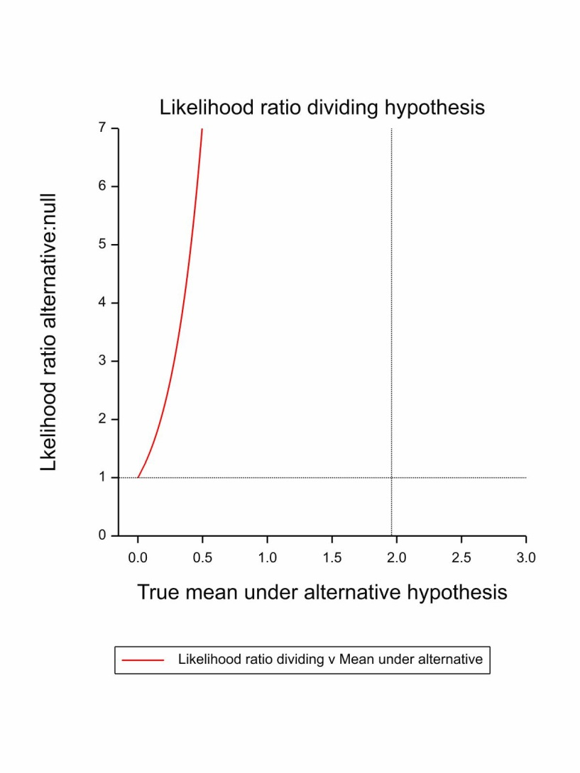
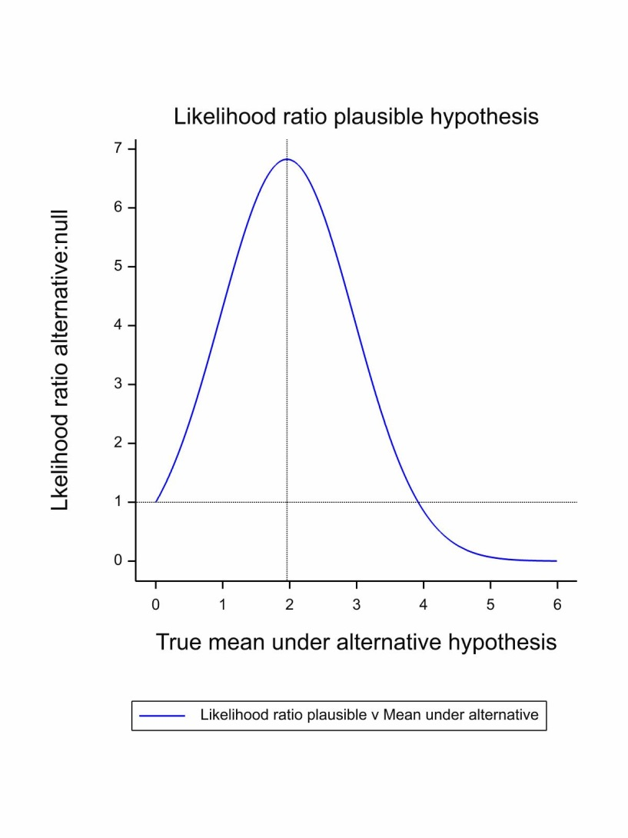
The situations compared

Slide 14
Goodman’s Criticism
What is the probability of repeating a result that is just significant at the 5% level (p=0.05)?
Answer 50%
  If true difference is observed difference
  If uninformative prior for true treatment effect
Therefore P-values are unreliable as inferential aids
Notes:
1. Goodman SN. A comment on replication, p-values and evidence. Statistics in Medicine 1992; 11: 875-879.

Slide 15
Sauce for the Goose and Sauce for the Gander
This property is shared by Bayesian statements
  It follows from the Martingale property of Bayesian forecasts
Hence, either
  The property is undesirable and hence is a criticism of Bayesian methods also
  Or it is desirable and is a point in favour of frequentist methods

Slide 16
Three Possible Questions
Q1 What is the probability that in a future experiment, taking that experiment's results alone, the estimate for B would after all be worse than that for A?
Q2 What is the probability, having conducted this experiment, and pooled its results with the current one, we would show that the estimate for B was, after all, worse than that for A?
Q3 What is the probability that having conducted a future experiment and then calculated a Bayesian posterior using a uniform prior and the results of this second experiment alone, the probability that B would be worse than A would be less than or equal to 0.05?

Slide 17
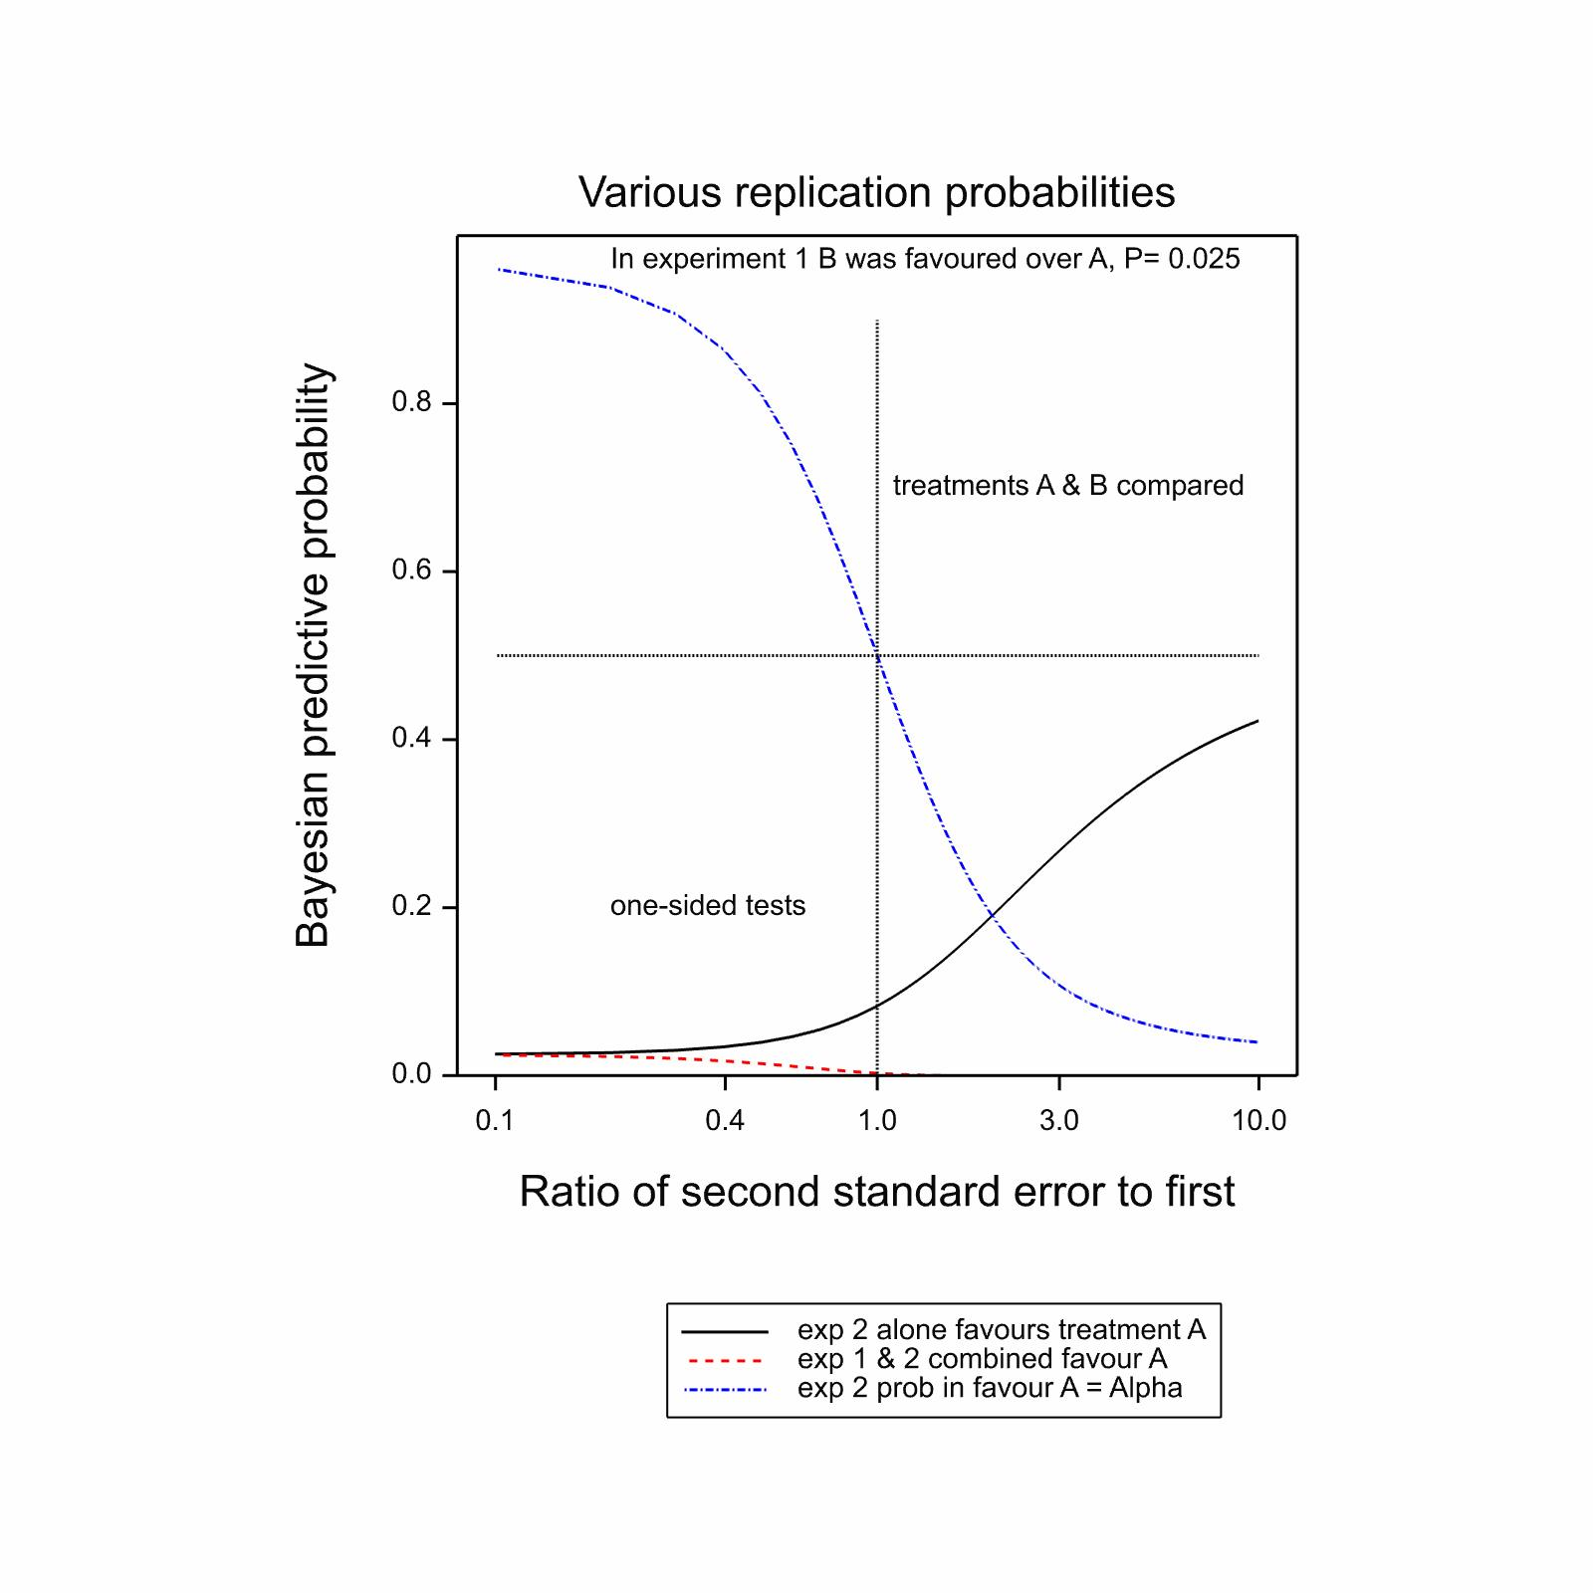

Slide 18
Why Goodman’s Criticism is Irrelevant
“It would be absurd if our inferences about the world, having just completed a clinical trial, were necessarily dependent on assuming the following. 1. We are now going to repeat this experiment. 2. We are going to repeat it only once. 3. It must be exactly the same size as the experiment we have just run. 4. The inferential meaning of the experiment we have just run is the extent to which it predicts this second experiment.”
Senn, 2002
Notes:
1. Senn S. A comment on replication, p-values and evidence, S.N.Goodman, Statistics in Medicine 1992; 11:875-879. Statistics in Medicine 2002; 21: 2437-2444; author reply 2445-2437.

Slide 19
A Paradox of Bayesian Significance Tests
Two scientists start with the same probability 0.5 that a drug is effective.
Given that it is effective they have the same prior for how effective it is.
If it is not effective A believes that it will be useless but B believes that it may be harmful.
Having seem the same data B now believes that it is useful with probability 0.95 and A believes that it is useless with probability 0.95.

Slide 20
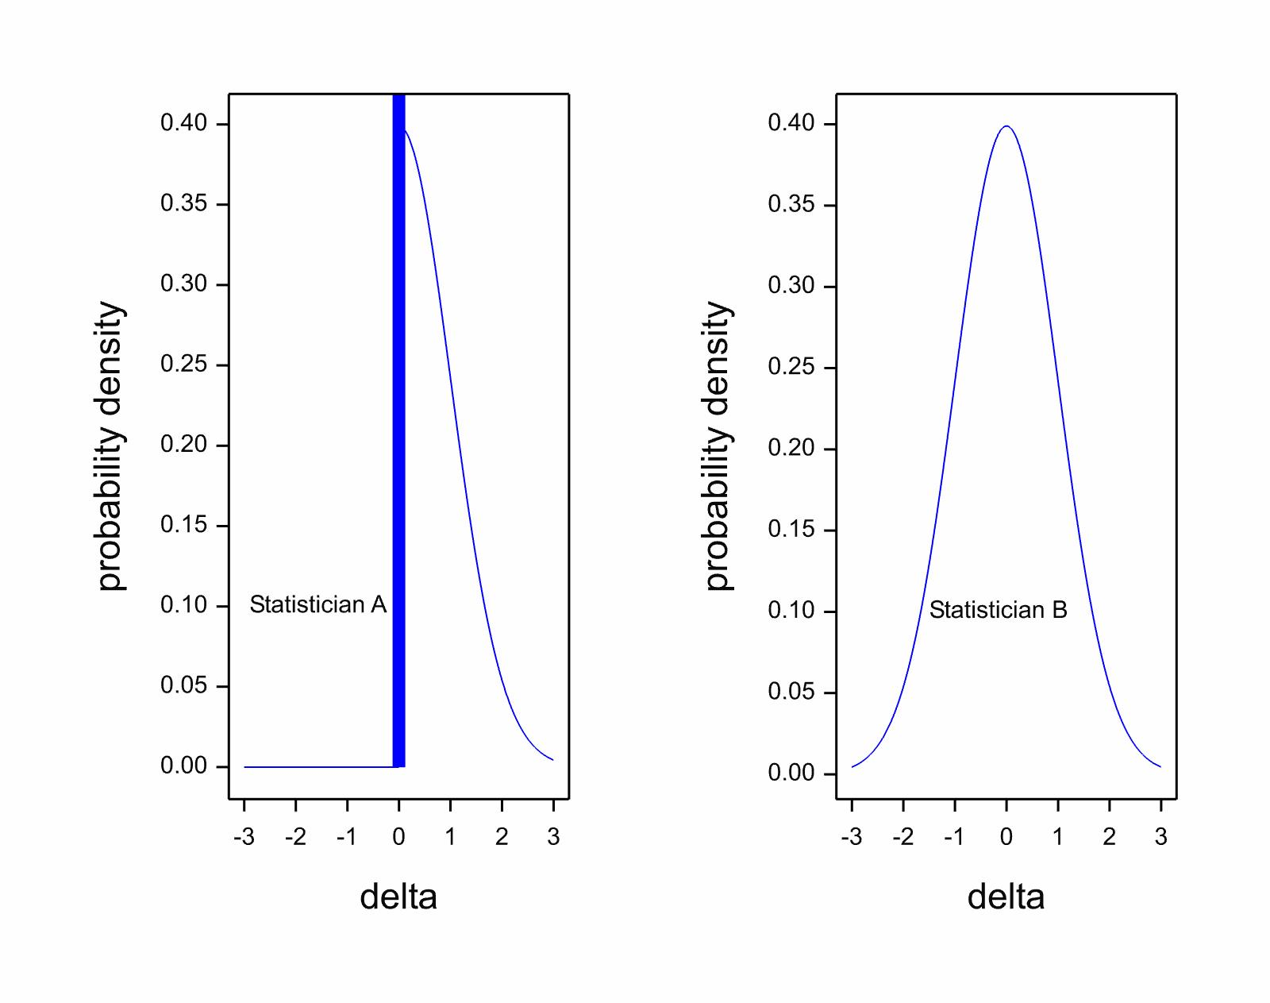
A Tale of Two priors

Slide 21
In Other Words
The probability is 0.95
And the probability is also 0.05
Both of these probabilities can be simultaneously true.
NB This is not illogical but it is illogical to regard this sort of thing as proving that p-values are illogical
‘…would require that a procedure is dismissed because, when combined with information which it doesn’t require and which may not exist, it disagrees with a procedure that disagrees with itself’
Senn, 2000

Slide 22
Are most research findings false?
A dram of data is worth a pint of pontification
Two interesting studies recently
  The many labs replications project
    This raised the Twitter storm alluded to earlier
  Jager & Leek, Biostatistics 2014
Notes:
1. Jager LR, Leek JT. An estimate of the science-wise false discovery rate and application to the top medical literature. Biostatistics 2014; 15: 1-12.

Slide 23
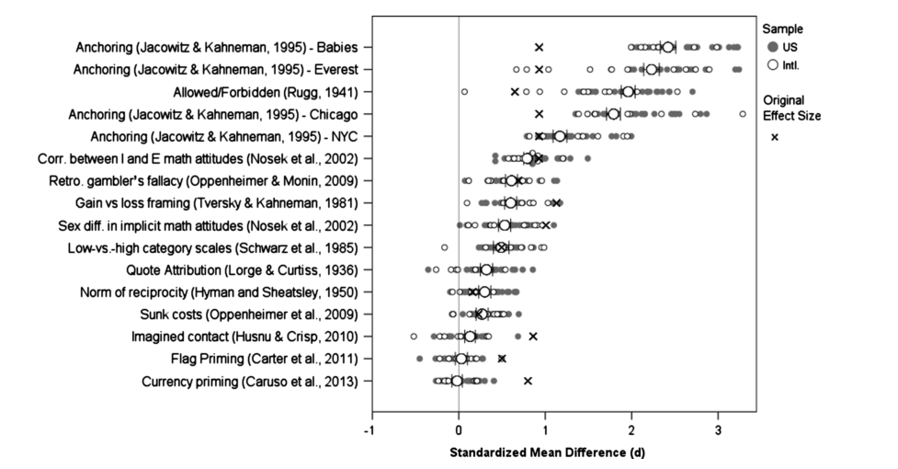
Many Labs Replication Project
Klein et al, Social Psychology, 2014
Notes:
1. Klein RA, Ratliff KA, Vianello M, Adams Jr RB, Bahník Š, Bernstein MJ, Bocian K, Brandt MJ, Brooks B, Brumbaugh CC. Investigating variation in replicability: A “many labs” replication project. Social Psychology 2014; 45: 142.

Slide 24

Jager & Leek, 2014
Text-mining of 77,410 abstracts yielded 5,322 P-values
Considered a mixture model truncated at 0.05
Estimated that amongst ‘discoveries’ 14% are false
$$f\left(p | a,b,π_{0}\right)=π_{0}uniform\left(0,0.05\right)+\left(1−π_{0}\right)tBeta\left(a,b,0.05\right)$$
Estimation using the EM algorithm

Slide 25
But one must be careful
These studies suggest that a common threshold of 5% seems to be associated with a manageable false positive rate
This does not mean that the threshold is right
  It might reflect (say) that most P-values are either >0.05 or <<0.05
  The situation might be capable of improvement using a different threshold
Also, are false negatives without cost?

Slide 26
A Penultimate Word to John
“The most important task before us in developing statistical science is to demolish the P-value culture, which has taken root to a frightening extent in many areas of both pure and applied science, and technology.”
John Nelder JRSS D 1999
Notes:
1. Nelder JA. From statistics to statistical science. Journal of the Royal Statistical Society Series D-The Statistician 1999; 48: 257-267.

Slide 27
My Conclusion
P-values per se are not the problem
There may be a harmful culture of ‘significance’ however this is defined
P-values have a limited use as rough and ready tools using little structure
Where you have more structure you can often do better
  Likelihood, Bayes etc
  Point estimates and standard errors are extremely useful for future research synthesizers and should be provided regularly

