Slide 1
H-likelihood approach to
high-dimensional multiple test
28 March 2015
London, UK
Youngjo Lee
Seoul National University
with Jan F. Bjϕrnstad, Donghwan Lee, Peirong Xu, Chris Frost,
Gerard R. Ridgway, Mike Kenward, Rachael Scahill, Jianqing Shi

Slide 2
Statistical Models with three objects
observable random variables (data):
fixed parameters:
unobservable random variables:
Lee and Nelder (1996) proposed the use of the h-likelihood for
Statistical inferences for these general model class such as
HGLMs & DHGLMs.

Slide 3
Bj rnstad (1996)
The information in the data about unobservables, and parameters are in the extended likelihood such as the h-likelihood.
The h-likelihood gives inferences for both
1. parameters and
2. unobservables.
Multiple testing is a prediction problem of whether a null hypothesis is true or not!

Slide 4
Prediction
What is the number of epileptic seizures in the next week ?
1. The classical Likelihood Method (Plug-in method)

Slide 5
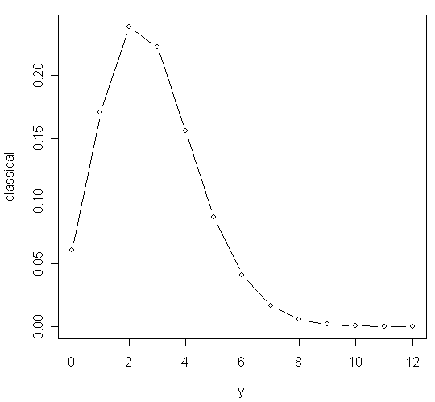

Slide 6
2. The Bayesian Method ( Pearson, 1920)

Slide 7
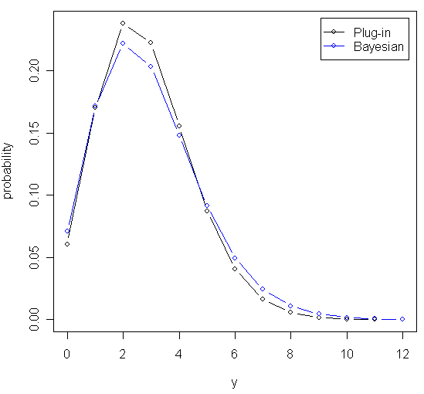

Slide 8
3. The H-likelihood method
( Lee and Nelder , 1996 : Profiling )
H-likelihood :
Profile h-likelihood :

Slide 9
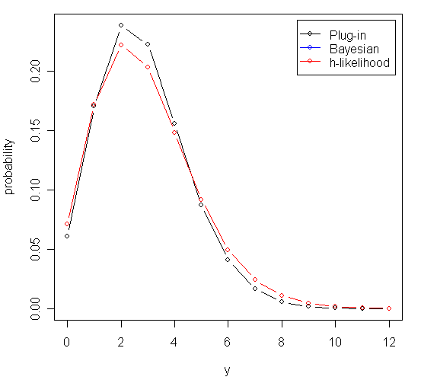

Slide 10
Multiple test is prediction problem of discrete
random effects (Lee and Bj rnstad, 2013)

Slide 11
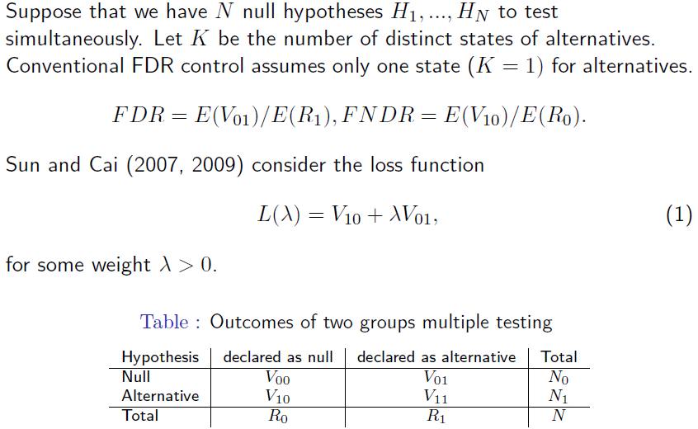
FDR control

Slide 12
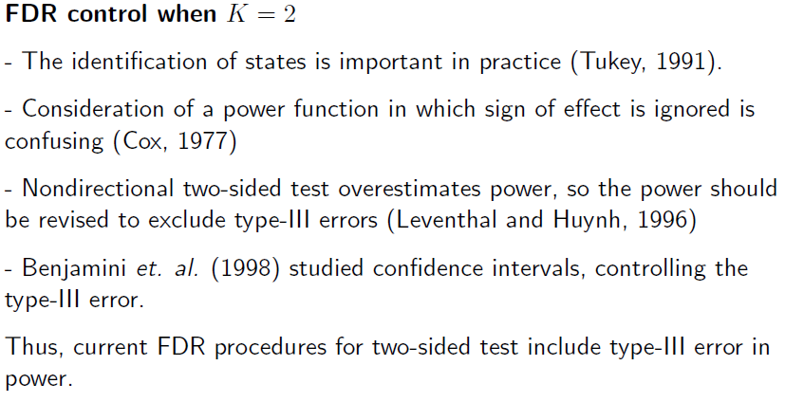
FDR control

Slide 13
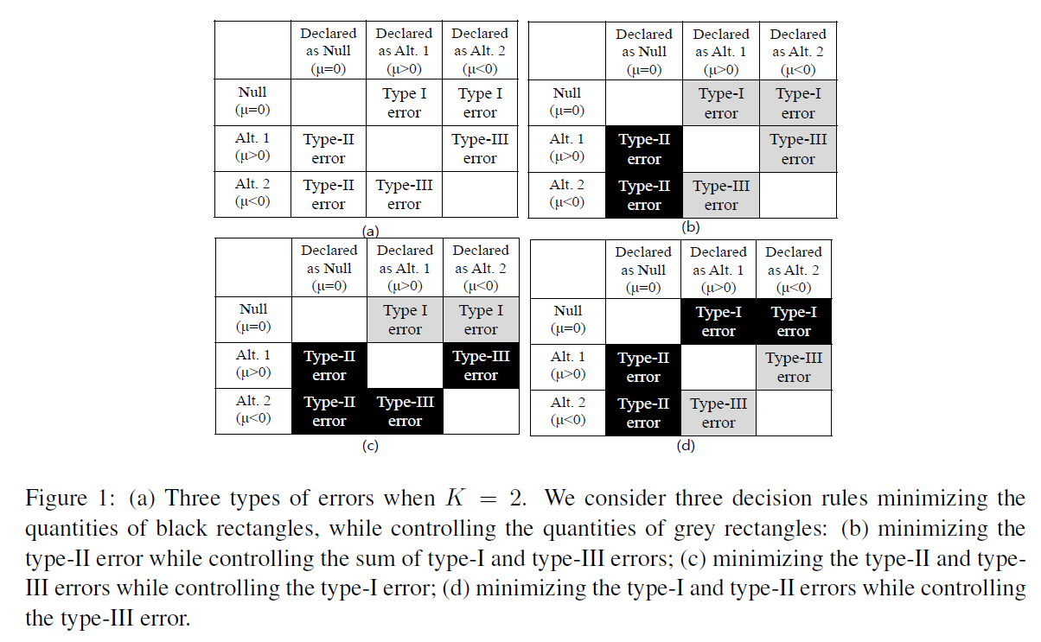
Directional FDR under HMRFMs
( Lee and Lee, 2015)

Slide 14
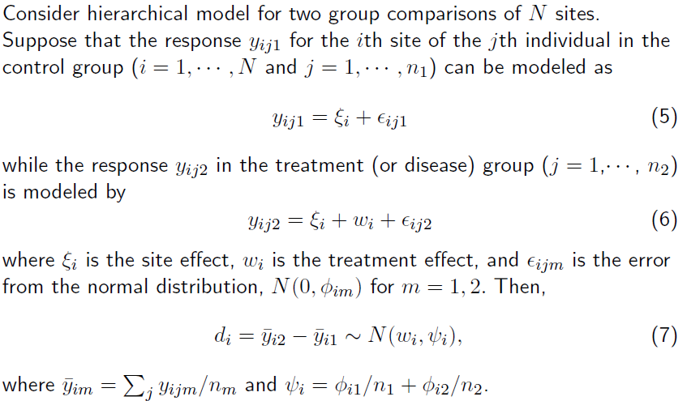
Extended likelihood approach

Slide 15
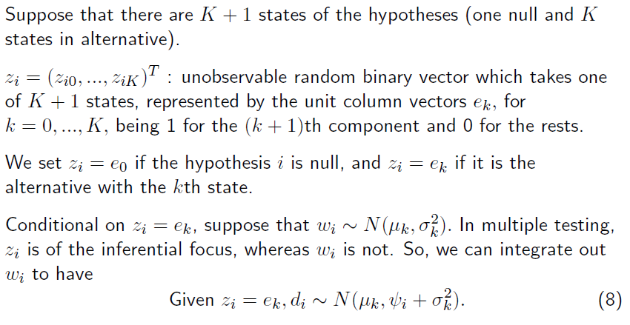
Extended likelihood approach

Slide 16
Hidden Markov Random field models
Multi-level logistic model:

Slide 17
Extended likelihood approach
The extended likelihood of HMRFMs can be written
To get consistent parameter estimates, the computation of marginal likelihood is necessary. But, in HMRFMs, the marginal likelihood is difficult to obtain, because it requires summation over all possible realizations of z.
Here, we use mean-field approximation for estimating parameters and Gibbs-sampler for calculating directional error rates.

Slide 18
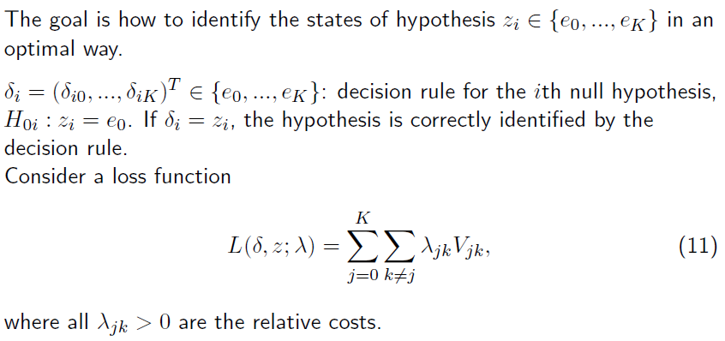
Extended likelihood approach

Slide 19
Extended likelihood approach
Theorem 1. Under HMRFMs, the optimal test is characterized by extended likelihood:

Slide 20
Decision rule for controlling various error rates
To control mFDR_{I+III}(Sum of type-I and type-III error), the optimal decision rule is
Similarly, to control mFDR_{I} (type-I error),
To control mFDR_{III} (type-III error),

Slide 21
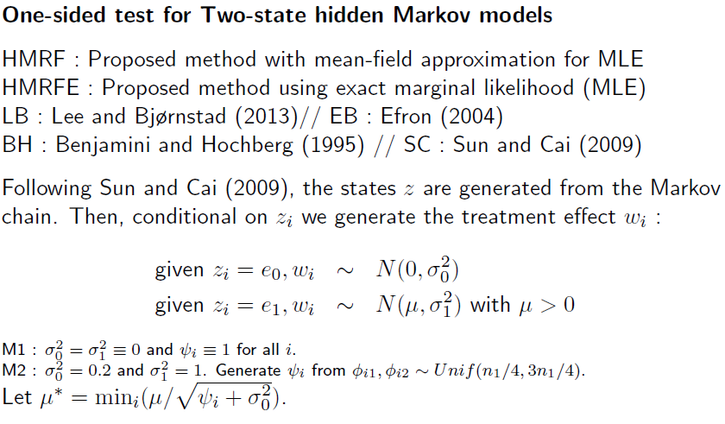
Numerical studies
One-sided test for Two-state hidden Markov models
(1-dimensional)

Slide 23
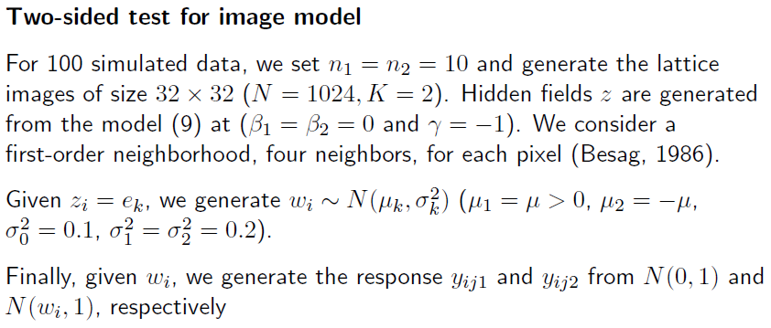
Numerical studies

Slide 24
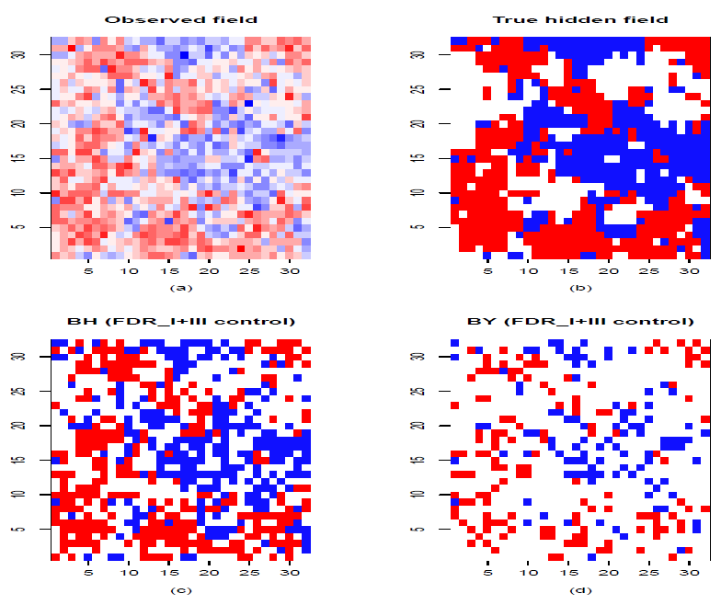
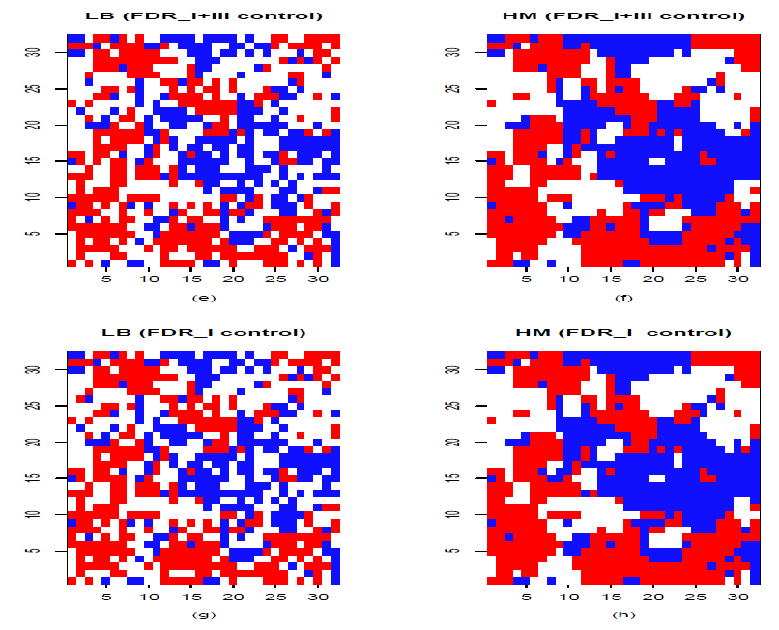
Numerical studies
Observed field
True hidden field
LB (FDR_I+III)
HM(FDR_I+III)
BH
BY
LB (FDR_I)
HM(FDR_I)

Slide 25
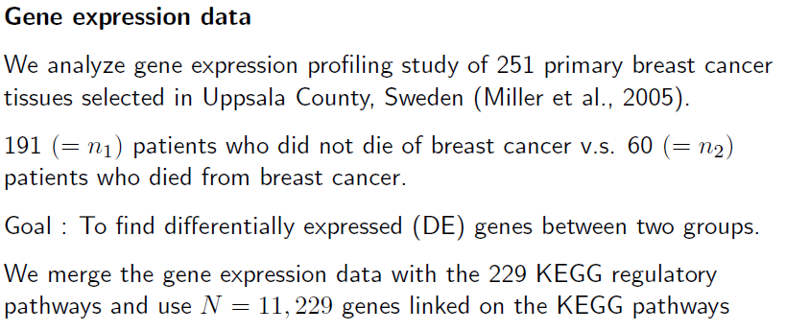
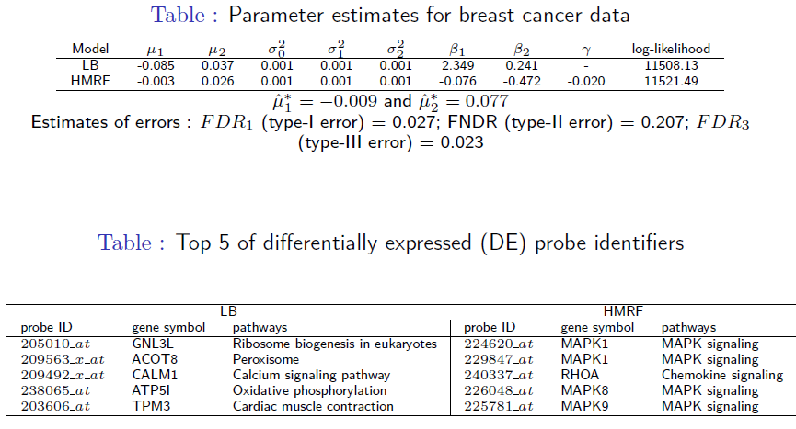
MAPK

Slide 26
Neuroimage data example
Positron emission tomography (PET) data
(Lee and Bjornstad, 2013)
28 healthy males v.s. 22 females.
Each PET images have N= 189,201 voxels.
Goal : To find the significantly different regions
(voxels) of the brain between males and females.

Slide 27
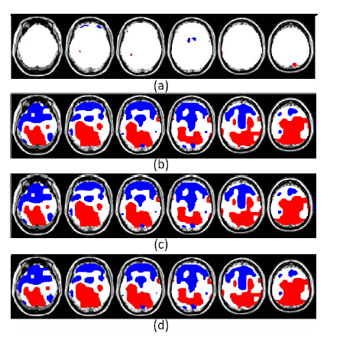

Slide 28
MIRIAD data analysis
(Lee, Lee, Frost, Ridgway, Kenward, Shaill)
Dataset:
First, we use baseline 68 NifTI images (45 Alzheimer patients and 23 controls)
283,905 voxels per image
Goal: Test where is significantly different between two groups

Slide 29
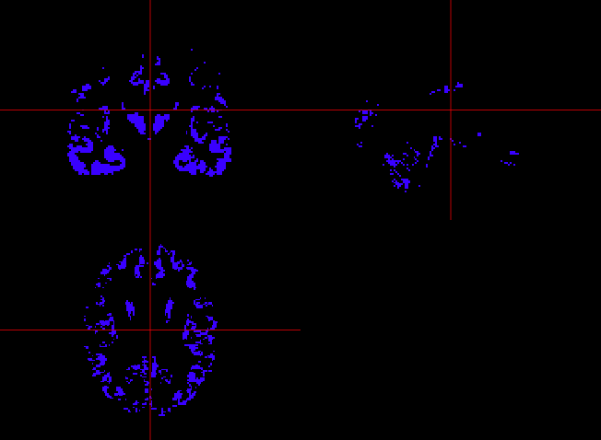
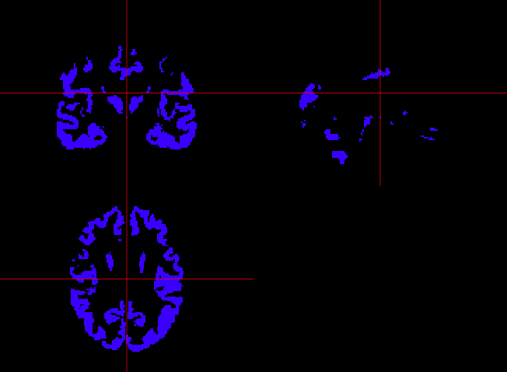
MIRIAD fMRI data (ongoing)
AD vs control group at FDR 0.01
BH (Benjamini and Hochberg)
Our method

Slide 30
MIRIAD fMRI data (ongoing)
Simulation using MIRIAD:
When some voxels are Alternative
(Divide AD group randomly in two (A and B), and add the signal to A )
Method (FDR=0.01) | Average of FDR | Average of FNDR
BH | 0.004 | 0.550
BY | 0.001 | 0.644
LB | 0.004 | 0.548
HM | 0.012 | 0.186

Slide 31
BLC mean correct latency data
(Xu, Shi and Lee)
84 girls and 57 boys, aging from 6 to 13 years old.
Each student finished the Big/Little Circle (BLC) test via an action video game.
56% action video game players (AVGPs) v.s. 44% non-action video game players (NAVGPs).
Goal : To detect the areas of age automatically that the significant differences between AVGPs group and NAVGPs group occur.

Slide 32
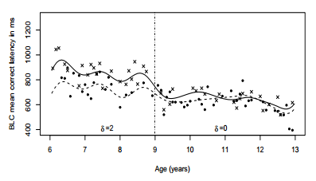
Ho(t): |diff(t)| <= 20 vs H1(t): diff(t) < -20 or H2(t): diff(t) > 20

Slide 33
Concluding remarks
When the null hypothesis is rejected it is important to control errors of incorrectly inferring the direction of the effect (type-III error). We proposed three ways of modifying the conventional FDR to accommodate such a need. We recommend to report the estimated of all three errors even if we control a specific FDR.
We derive the optimal test under HMRFMs. In real data analysis, likelihood-ratio test selects a HMRFM as the final model, showing an evidence of dependency among the observations. Thus, it is important to search for the best-fitting model in order to enhance the performance of the multiple test.

Slide 34
Thank you !

